Slide 1
The battle of the neighborhoods
Finding best socio-economically suitable location for living in Jersey City, US.

Slide 2
Business Problem
Jersey City is the latest alternative to New York City’s sweltering real estate market
Rental websites do not holistic snapshot of competitive difference between neighborhoods
Rental websites as the data is motivated to sell apartment
Visiting several websites and venue APP and crunching information is overwhelming and take lot of time
Data science provide deep insight into massive and complex data
Use data science to finds neighborhoods with similar characteristics in terms of socio-economic indicator and venues

Slide 3
Target Audience
New immigrants moving to NYC for job
Students coming for study in NYC or Jersey City colleges
Local want to move to better neighborhood in the city
Even resident of NYC looking for cheaper areas for longer stays.
Real Estate Investor who want to invest in potential growing areas and gain from rising rental prices.

Slide 4
Data Source
The data to be used for this project comes from four different locations:
Venues data from Foursquare APIs
New Jersey Neighborhood Names, Median Household income and Population - Available on https://statisticalatlas.com
Median Rent Price from rental websites
Geographic coordinates of Neighborhoods from distancesto.com

Slide 5
Methodology
Dataset is developed in two stages.
In First stage, we collect socio-economic data and geometric data of neighborhoods
In Second stage we enrich the dataset with Venues data using FourSquare APIs
Neighborhood vs Venue Category matrix using one hot encoding on Venue Category
Takin mean of the frequency of occurrence of each category and group rows by neighborhood
Create a dataset of top 10 most common venue per neighborhood based frequency of occurrence.
Apply StandardScaler and create scaled features for model building

Slide 6
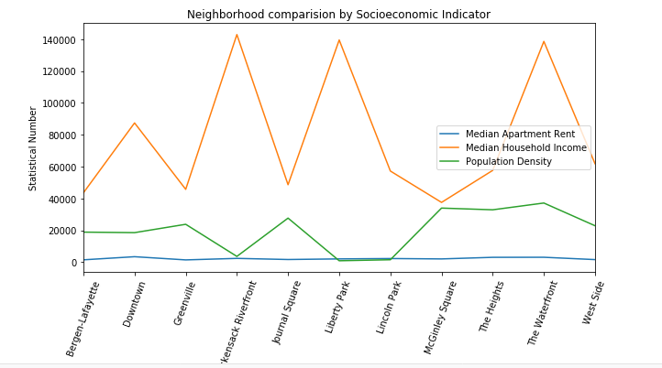
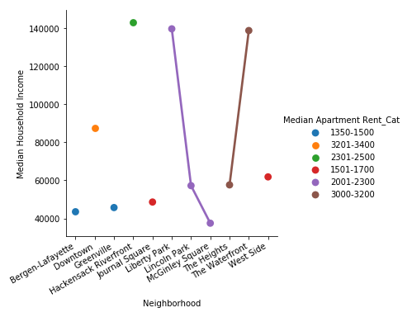
Methodology- Data Exploration
High income group generally prefer to stay in less densely populated neighborhoods like Hackenstack Riverfront, Liberty Park
No direct connection between median household income and money individual want to spend on house rent and choice of neighborhood.

Slide 7
Methodology- Clustering and Segmentation
Run k-means on the scaled features and cluster neighborhoods into 5 clusters
Folium library to map and visualize the clusters
Summarize Clusters and extract distinct characteristics

Slide 8
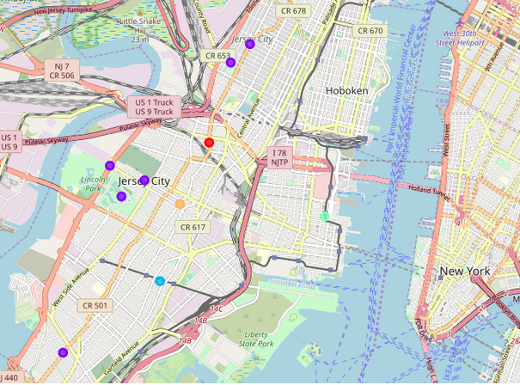
Results
Most of the habitat is in west part of Jersey City.
The Waterfront neighborhood appears to be home for high income group people.
McGinley Square has similar venues like The Waterfront. Contrastingly, median household income of this neighborhood is lowest in the Jersey City and median house rent is less compare to The Waterfront.
Bergen-Lafayette appears to be a neighborhood for people with medium to low household income.

Slide 9
Results
Journal Square is another neighborhood for people with medium to low household income. Indian Restaurant is top among 10 most common venues which suggest people from South Asia origin could be more in this neighborhood
Rest all other neighborhood are clustered in cluster2. Common about these neighborhoods is all are in west part of the city and primarily have venues essential for household in top 10 most common avenues.
Downtown has highest median household rent whereas neighborhoods in northwest are home for high income group people.

